Slide 1
Credit Scoring
The POWER OF Data to anticiped risk
How data and algorithms are transforming credit risk assessment
Randriamiaramanan Harivelo Yvan

Slide 2
Why is credit scoring essential?
1.Financial instutitions must assess risk before granting loans
2. Traditional process often slow, costly, and impresives
3. Scoring models help automate and standardize decision-making

Slide 3
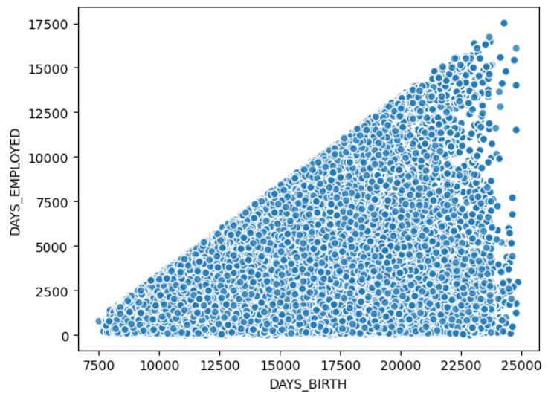
Detection of employee seniority
This steps analyzes the correlation between customers seniority and age to assess their creditworthiness
This charts highlights a logical trend between customer age and job seniority, suggesting that the data provided is consistent and reliable. As except, older clients tend to have longer job tenure.
This reinforces the credibility of the information and serves as an initial validation of data quality

Slide 4
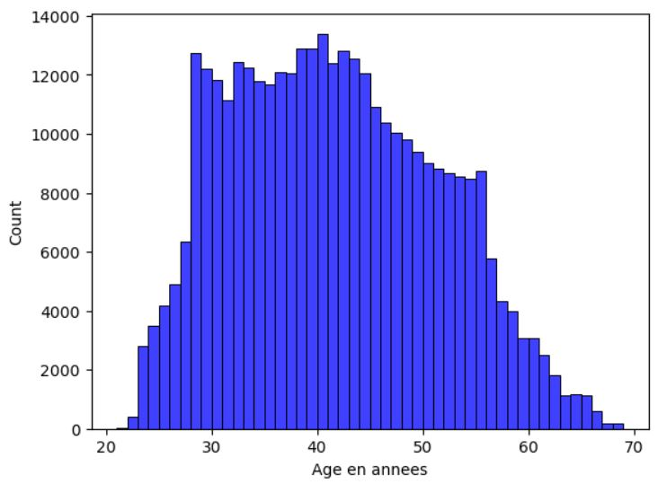
Dominant Age Range of customers
The histogram shows that most customers are between 30 and 45 years old, which may indicate a more stable and potentially more creditworthy customers profile. This distribution could also reflect a specific targetpopulation of the bank

Slide 5
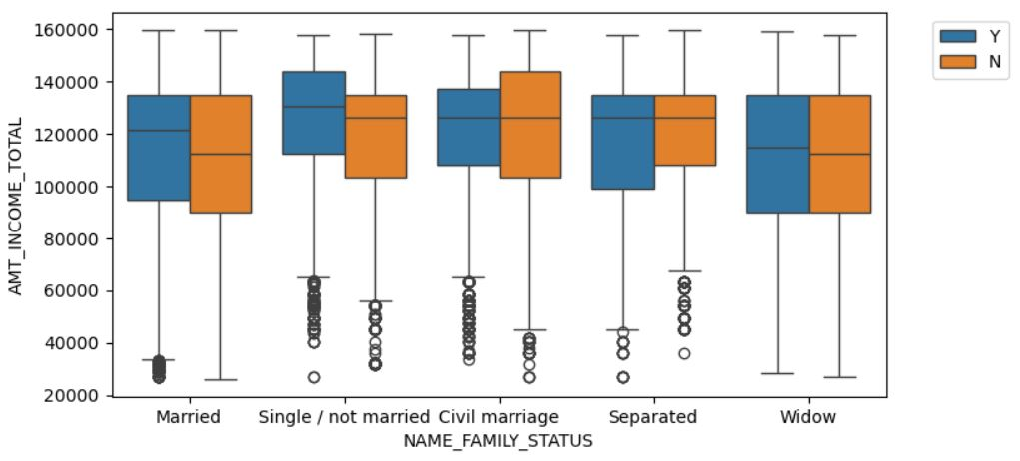
Income analysis by martial status and homeownership
The median, which represens the central income value(where half individuals earn more and half earn less)
Single homeowners have higher incomes than non-homeowner
Divorced individuals, there is no significant difference between the incomes of homeowners and no homeowners
Married homeowners also earn more than no homeowners, suggesting that homeownership is associated with higher income
Outliers represent clients whose annual incomes are significantly lower than the majority of other clients in each group. These clients appear as isolated points outside the normal income distribution

Slide 6
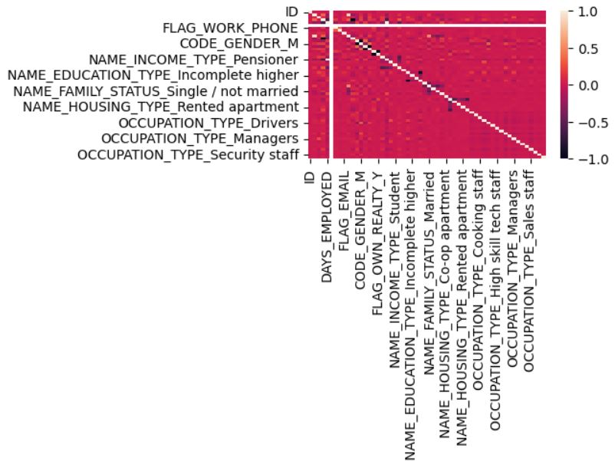
Feature Engeneering
Feature engineering allows the model to better capture the complex relationships between variables and achieve more accurate results.
Feature engeneering allows us to observe that annual income has weak correlations with the following variables : “Occupation_Type_Managers, Education_Type_Higher and Flag_own_car”

